Slide 1

FlixReview
End-to-End journey

Slide 2
FlixReivew
SLIDE DECK CONTENTS
Product Overview
Features
The Architecture
How did I create my project ?
What does my project look like?
Self Reflection

Slide 3
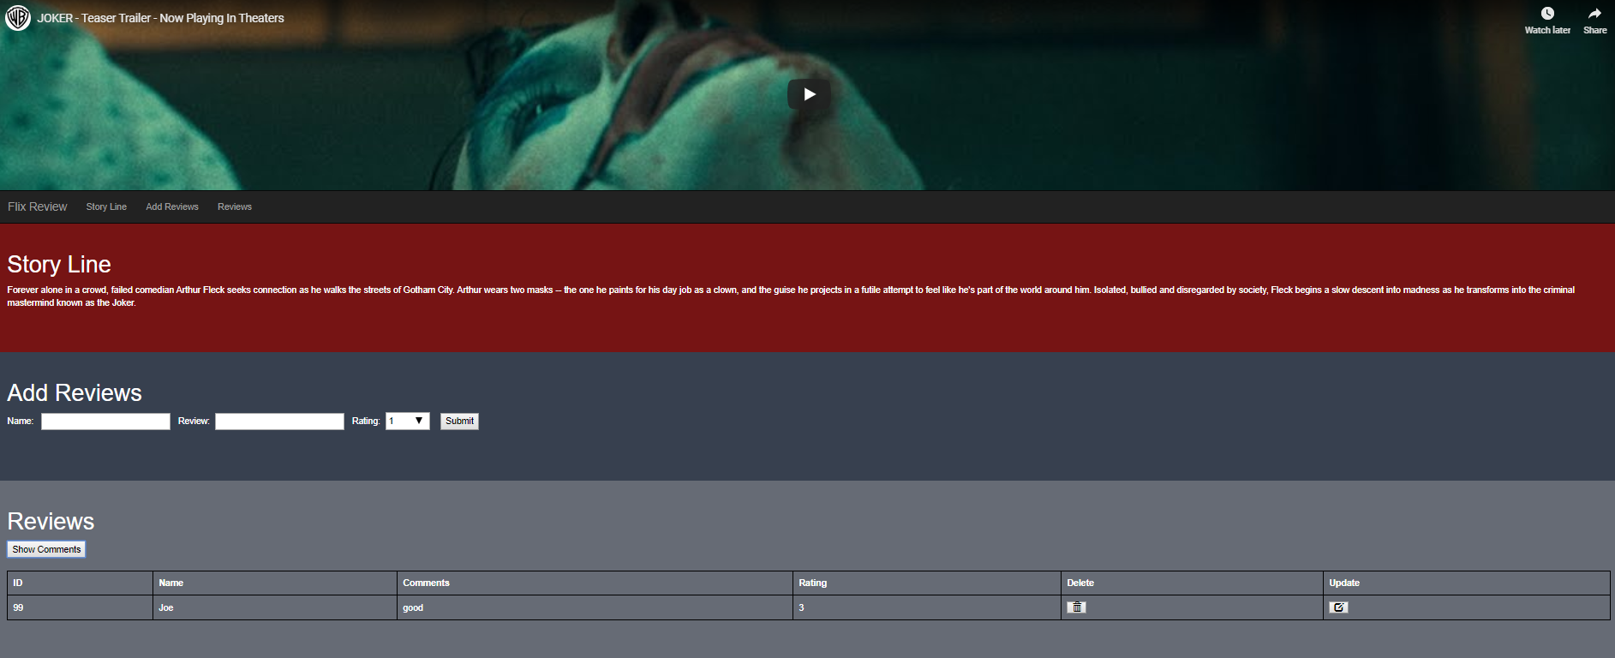
Product Overview
As a movie lover, before I choose a movie to watch, I want to see user rating and comments.
FlixReview allows user to post comments and ratings on a movie which will help the viewer to know if it is really worth their time to watch that movie.
Why movie reviews are important ?
Have significant effect on the consumer thought process.
Can be used as marketing tool by film production studios.

Slide 4
Features
Add Reviews : allows a user to post their review and rating regarding a movie.
Reviews: enables a user to see all the ratings and comments given by a viewer for a particular movie.
Delete: allows a user to delete a posted review.
Update: allows a user to update a review.

Slide 5
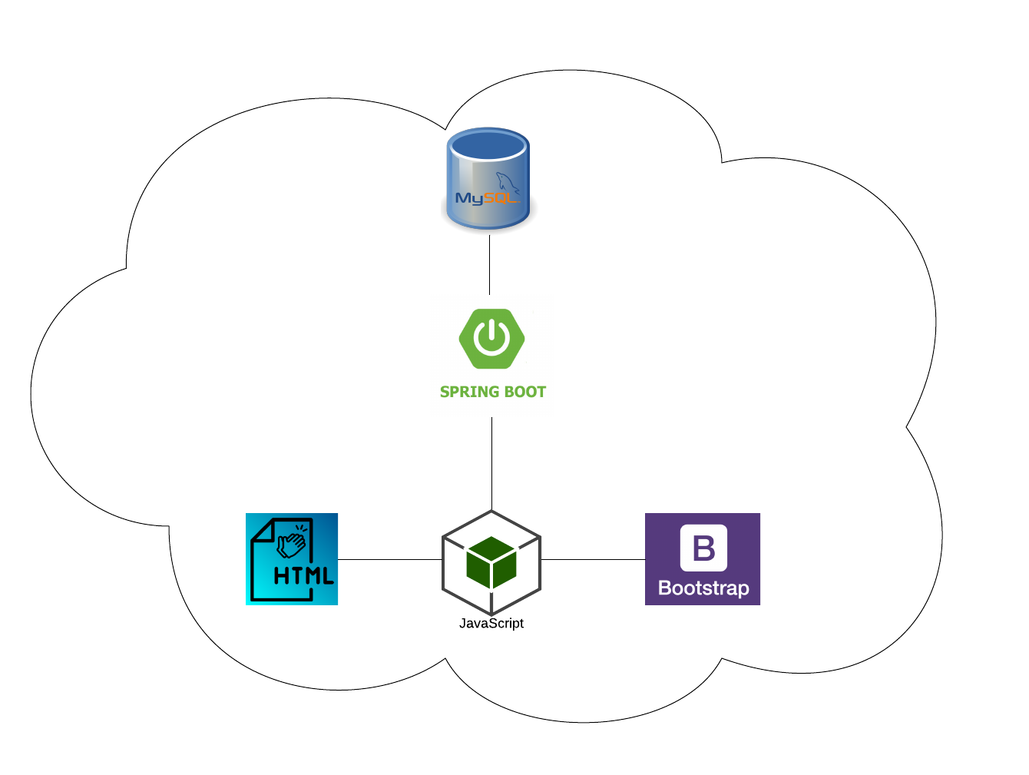
The Architecture

Slide 6
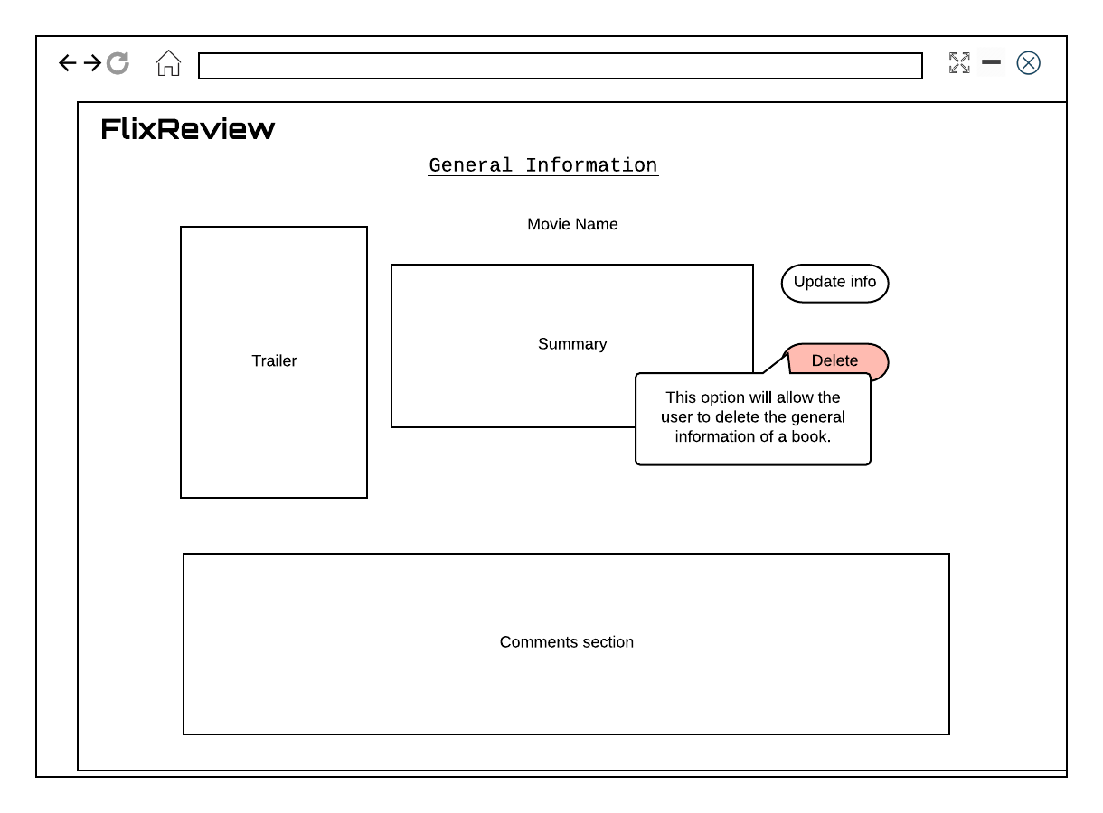
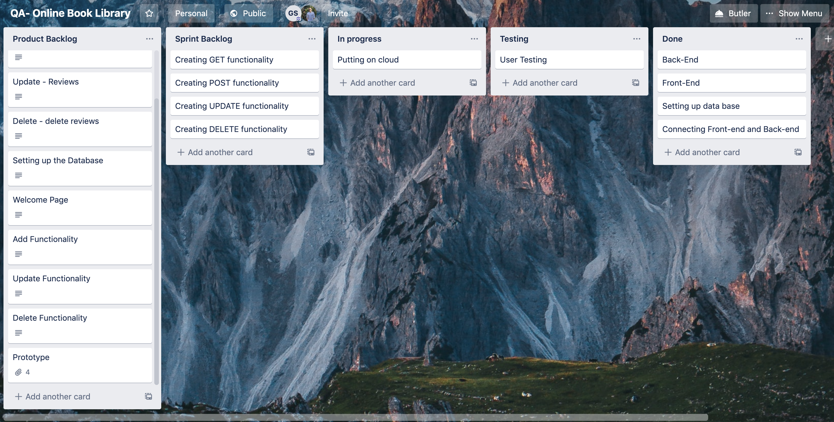
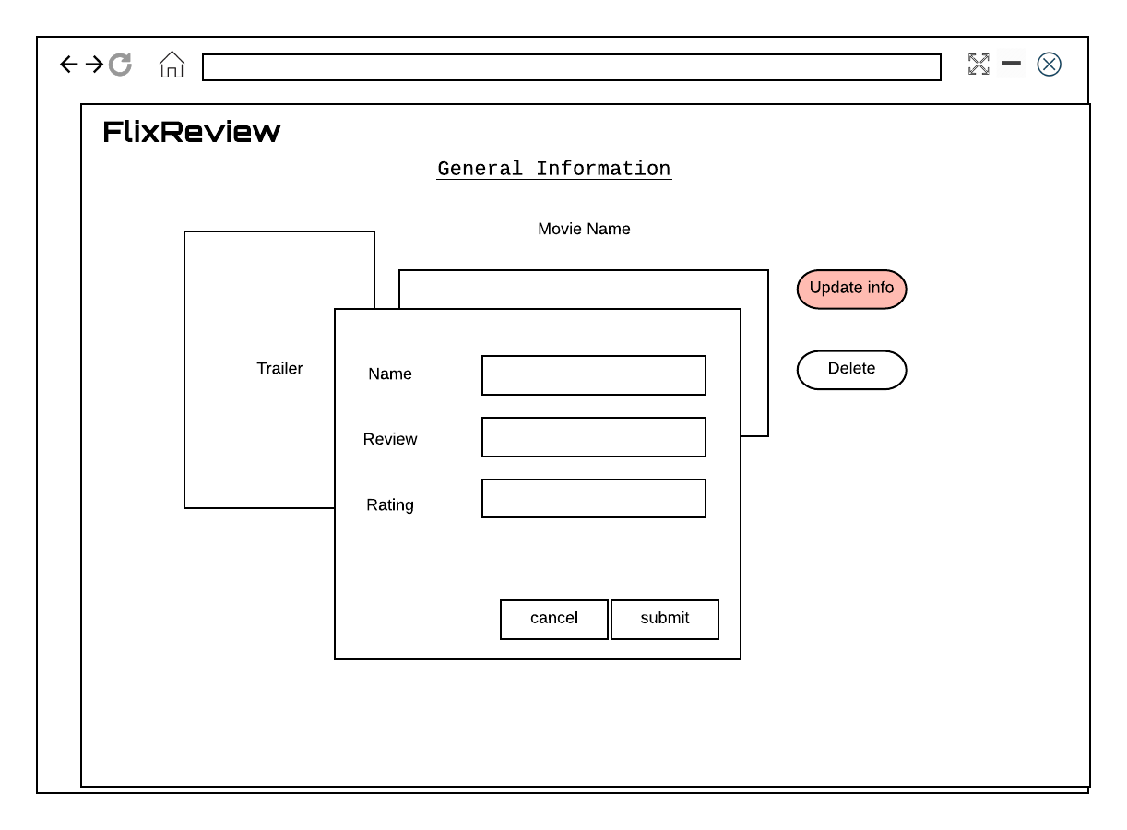
How did I create my project ?
Trello : provided me visual overview of what is being worked or completed.
GitHub : used to manage my project.
Prototypes : initial version of my project.

Slide 7
What does my project look like ?

Slide 8
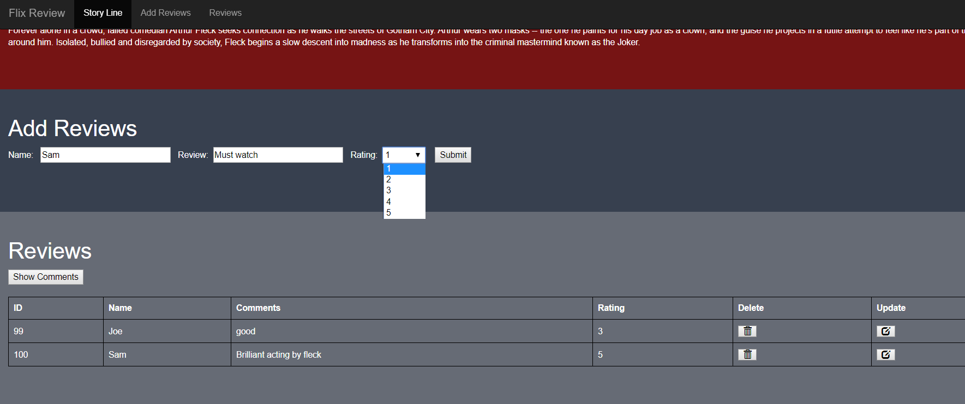

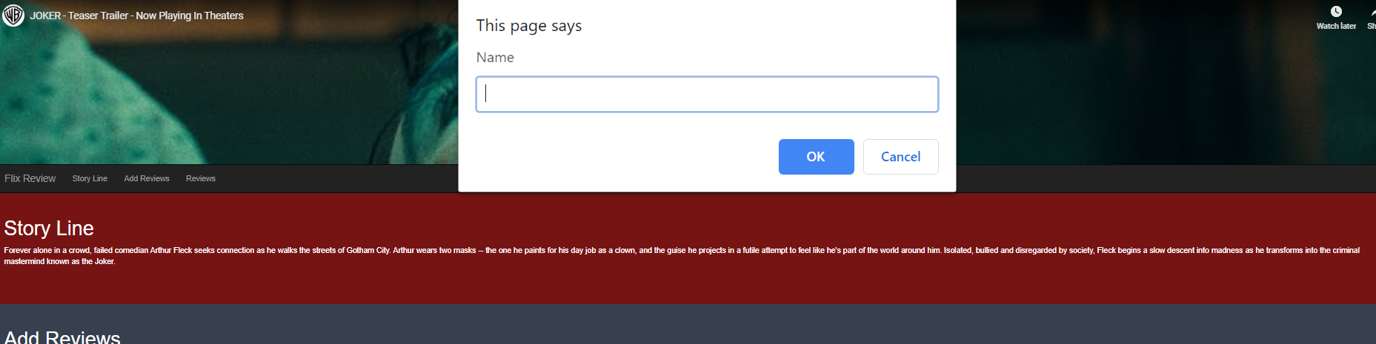
What does my project look like ?
Adding a new review.
: removes a comment.
Updating a existing a review.

Slide 9
Self Reflection
What went well during the project ?
Completed my project.
Time management.
Collaborated with TDPers to solve problems.
Improved my skills.
Learnt how to create a micro service with Spring Boot.

Slide 10
Self Reflection
What didn’t go so well during the project ?
Time constraints.
Change in scope.
Running the backend on the cloud.
Managing Git

Slide 11
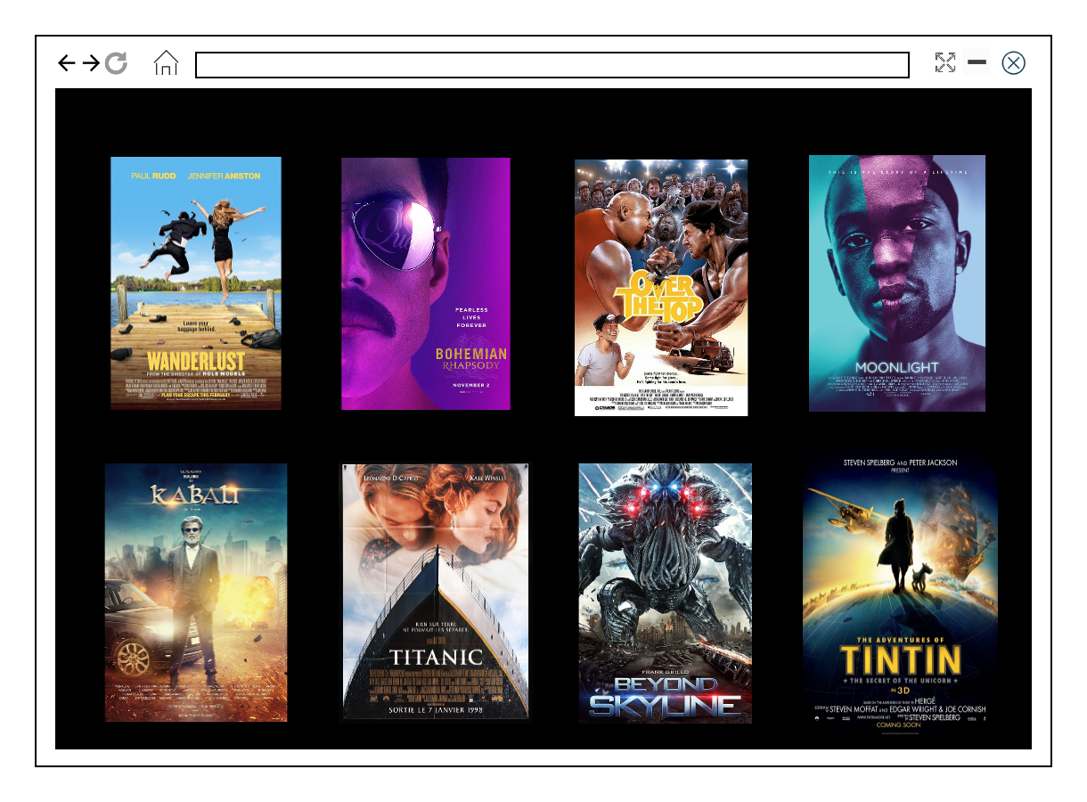
Self Reflection
What would I like to do in future ?
Edit option for specific fields.
Home page with clickable posters.
User Login : will allow the user to only delete or update their personal review.
Running FlixReview on cloud.
Automated testing with selenium & user testing.
Maintaining user stories, sprint backlog and product backlog.
Creating documentation.

Slide 12
Thank you for listening
Any questions ?

